Slide 1
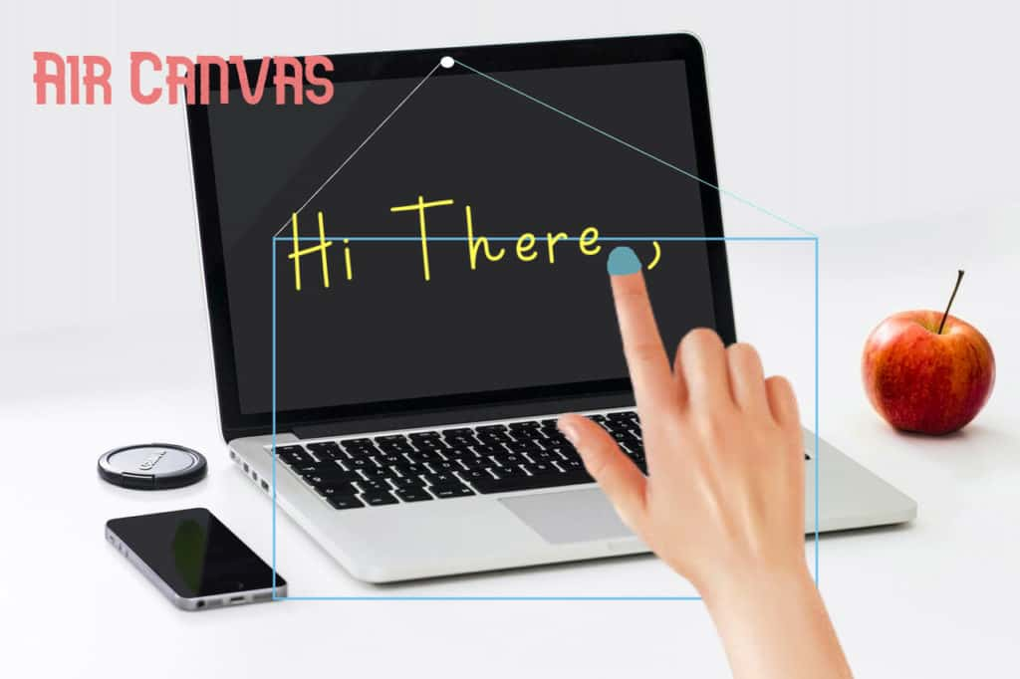
Air Canvas Project
Under the guidance of
Raghavender Sir
By
Chandana,Sahith,Ganesh,Jairam,Ronith

Slide 2
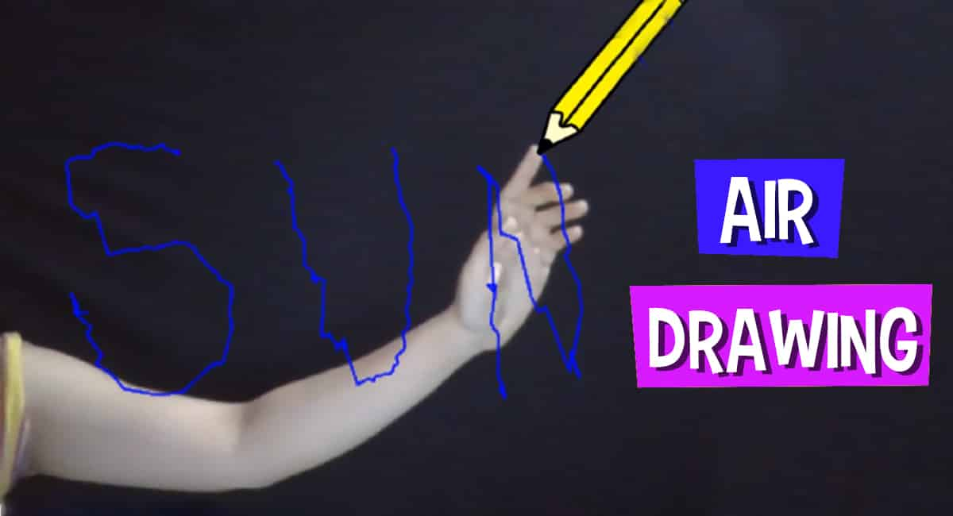
ABSTRACT
With increasing technology each sector need to be modernized. With the improvement of clever gadgets, the system can be now controlled virtually with aid of using human gestures.
While using paint , sometimes we feel difficult to draw and feel like drawing our imagination just by waving our hand.
Writing in air has lately become one of the most interesting and difficult research areas in image processing and pattern recognition.
Air Canvas is a hands-free digital drawing canvas that uses a good quality HD camera ,Opencv to recognize and map hand gestures onto a screen, using mediapipe to recognize hands .

Slide 3
PROPOSED SYSTEM
Air Canvas is a hands-free digital drawing canvas that uses a good quality HD camera ,Opencv to recognize and map hand gestures onto a screen, using mediapipe to recognize hands.
The user’s “fingertip” acts as a pen and can be modified in size and color by built-in buttons. The direction of the finertip is controlled completely using OpenCV and hand gesture detection by the mediapipe.
The hand landmarks are detected and the chosen operations are performed.

Slide 4
Methodology
The objective is to create a free space where one can draw in air freely.
The steps include:
Run Or Execute the Code
Webcam Starts
Detects Hand Landmarks
Capturing the Video and Processing
Detecting Which Finger Is Up and Performing the Particular Function
Saves the video and Audio files

Slide 5
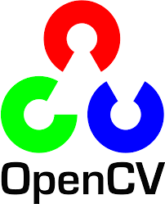

Technologies Used:
1.OpenCV:
OpenCV is the huge open-source library for the computer vision, machine learning, and image processing and now it plays a major role in real-time operation which is very important in today’s systems.
2.Numpy:
NumPy is a general-purpose array-processing package. It provides a high-performance multidimensional array object, and tools for working with these arrays. It is the fundamental package for scientific computing with Python.
NumPy
Mediapipe
Handmark 1

Slide 6

3.MediaPipe:
Mediapipe is a cross-platform library developed by Google that provides amazing ready-to-use ML solutions for computer vision tasks.
Hand Tracking: Object detection and Tracking: Face Mesh:

Slide 7
4.Hand landmark detection:
After detecting the palm over the whole image, our subsequent hand landmark model uses regression, or direct coordinate prediction, to accomplish precise keypoint localization of 21 3D hand -knuckle coordinates inside the detected hand regions

Slide 8
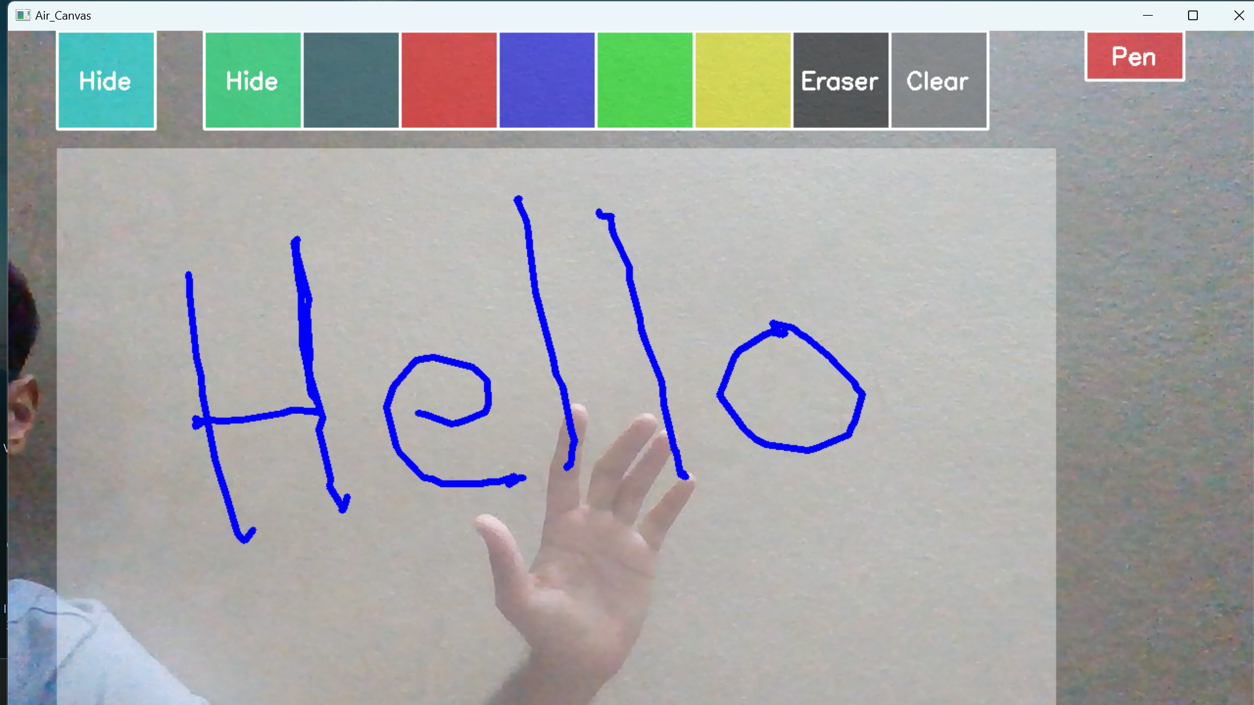
Output screens
Selecting blue colour and writing

Slide 9




Real Time Usage
Virtual Drawing
Notes Making
Explanation in webinars
Highlighting Pdfs
We can upload the video of the session in Youtube for future reference or sharing.

